Slide 1
The Snake Game

Slide 2



HELLO!
I am
Sanjay Krishna S R
/sanjaykrishna1203

Slide 3
Overview and Goals

Slide 4
OverView:
The project aims to create a user controlled Snake that collects the fruits and gets bigger without hitting the boundaries or itself. I have created the project with the help of C#
as the language is more comfortable.

Slide 5
Goals:
To Create a snake that eats the fruits and gets longer.
To end the game when the snake hits the boundaries of itself
To control the snake with the keyboard controls.

Slide 6
How I Did?
Applied the Basic Concepts of C# and Windows forms which I learnt recently. Googled a Lot for the Bugs I got.

Slide 7
What I Learnt?
From this Project I learnt A lot of new Topics which were used in this project. I learnt to solve the errors and find the bugs in the program. It Enhanced my Skills a lot.

Slide 8
Enhancements Received:

Slide 9
Enhancements:
Food Should not be Produced in the Body
Speed of The Snake should be given by the user.
Should have a Start Button.
Scores should be scored in a file.
High Score should be Given.

Slide 10

Lets Jump to the
OUTPUT

Slide 11
How they are Implemented?

Slide 12
Food Should Not be Produced In the Body:

Slide 13
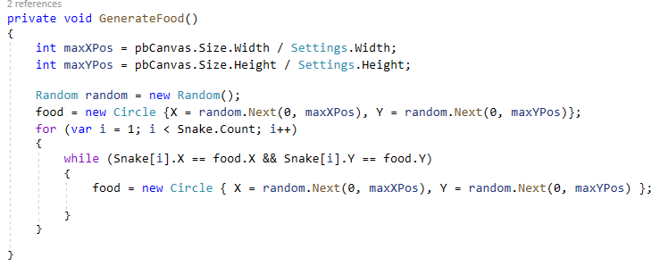

Slide 14
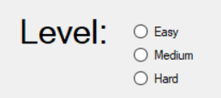
Speed of The Snake should be given by the user

Slide 15
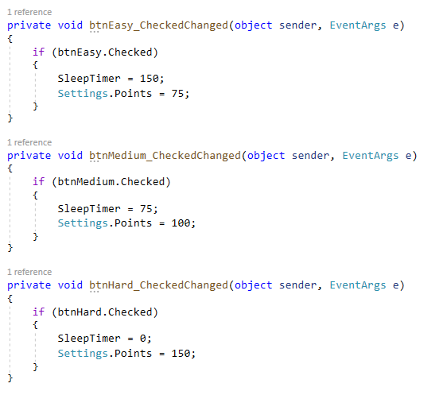

Slide 16
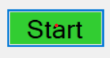
Should have a Start Button

Slide 17
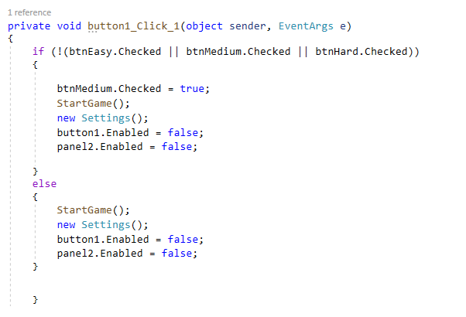

Slide 18
Scores should be scored in a file.

Slide 19
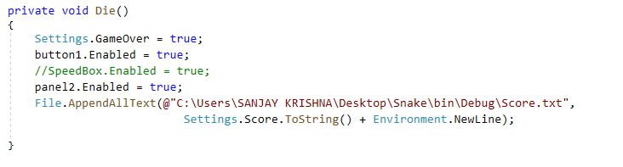

Slide 20

High Score should be Given.

Slide 21
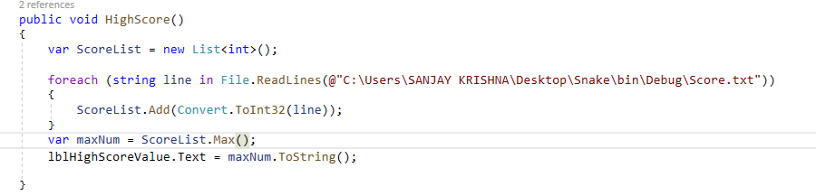
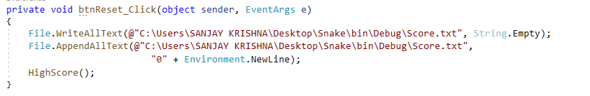

Slide 22
THANKS!
Any questions?

Slide 23
Special thanks to
Mr. Akash Sareen
Mr. Tushar Choudhary
For the Guidance and Providing Enhancements.

